Slide 1


Neighbourhood RECOMMENDER Finding best location to open a Indian restaurant in London, uk
at
NETPARAM TECHNOLOGIES PVT. LIMITED
IT Division of CDAC , Jaipur
Submitted By: KISHAN KUMAR
Submitted To: SUNIL DHANKAR

Slide 2
CONTENTS
Introduction
Business Problem
Data Description
Data features
Methodology
Results and Discussion
Conclusion

Slide 3
Introduction
London is one among the cities in the world, where a large Indian Population resides.
It is referred to as the Arch of the world because of its role as the once world’s most powerful kingdom.
It has a population of over ten million, making it a megacity and most populous city in United Kingdom.
Being a demographically diverse city, the needs of the residents are also increasing rapidly.
Hence, any new organization or an existing one should keep up with their pace in supplying the needs of the customers.

Slide 4
Business Problem
Our customer is ABC Restaurant, which is an International Indian Restaurant Brand and also a market leader.
ABC Restaurant has recently planned to expand its business to the United Kingdom, and they want to start this journey from the heart of the UK itself.
Given the extremely large size and the population of the city, our customer wants to identify the best neighbourhood area to open its first Indian Restaurant covering the majority of the population and facing least competition from other restaurants.
The problem statement will be: Which neighbourhood has most Indian population and has lesser number of INDIAN RESTAUARNT’s?

Slide 5
Data Description
The data to be used in this project is not readily available. Hence, the data has been obtained from various sources such as
Foursquare, which is a local search-and-discovery mobile and web based app which provides search results for its users.
Wikipedia, which has the details about the neighborhoods in LONDON. https://en.wikipedia.org/wiki/List_of_areas_of_London
The geographic coordinates of each location have been obtained through Geopy(https://geopy.readthedocs.io/en/stable/)
The Indian population in LONDON has been obtained from : https://en.wikipedia.org/wiki/Indian_community_of_London

Slide 6
Data Features
As we have to explore and identify the neighbourhoods in the city of London, the London neighbourhood data is the crucial data for this project.
The data about each neighbourhood is not readily available, hence we have to scrape the Wikipedia page and obtain the data.
In order to obtain the coordinates, we make use of geopy library in Python.
We also need information about each neighbourhood which is obtained through FourSquare API.
The population about each neighbourhood will let us know which neighbourhood is more preferable.

Slide 7
What is new ?
Instead of simply taking the consideration of Percentage of Indian Population living in a particular Neighbourhood, we are here working with both the Density of Indian Population and Density of Indian Restaurants in a particular Neighbourhood to open a new Restaurant.

Slide 8
Block diagram
Scrap Data from Wikipedia.
Store the Data into a data frame
Assign coordinates to each neighborhood
Plot each neighborhood onto the map
Apply k_means Clustering algorithm
Select top 10
Venues from each Neighborhood
Get venues using Four Square
Divide dataframe into 5 clusters
Analyze each Neighborhood for
Best suitable location to open the restaurant

Slide 9
Methodology
Methodology involves the following stages:
Data Preprocessing
Exploratory Data Analysis
Clustering (K-Means Clustering)

Slide 10
Data Preprocessing
Scraping from the Wikipedia page
Obtain coordinates for each location using geopy library
Finding columns with null values and replacing them
Merge the neighbourhood dataset with population dataset

Slide 11
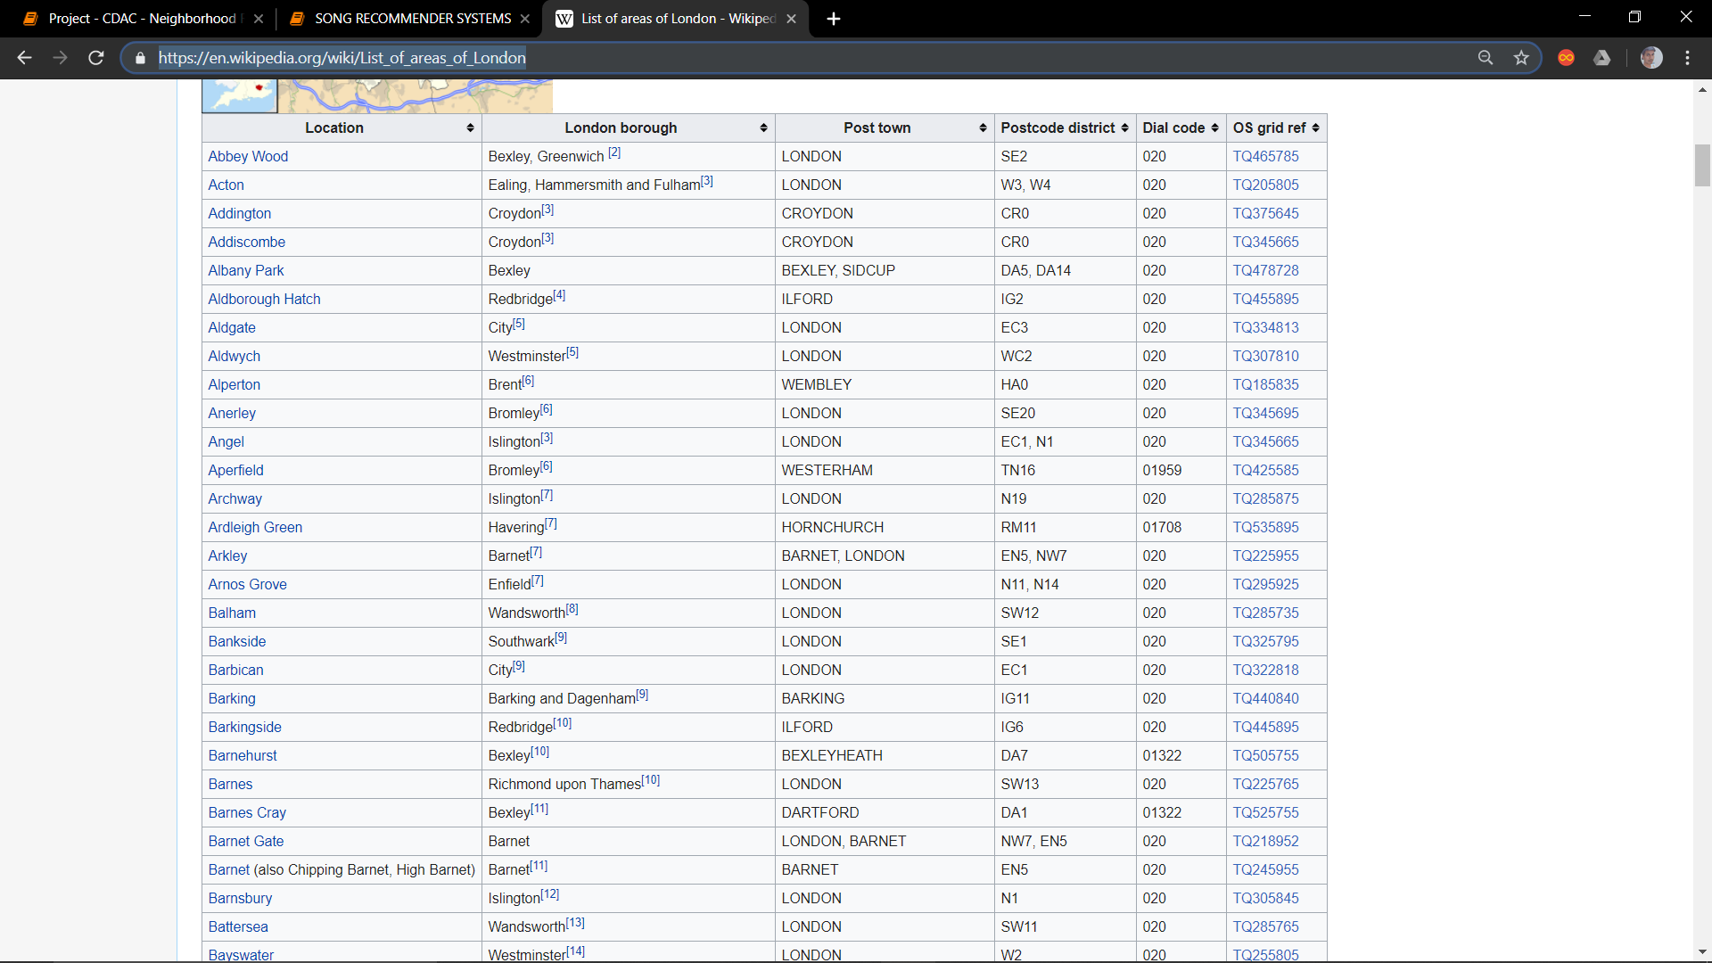
Data Preprocessing
Data from Wikipedia
Processed data from WIKIPEDIA page.

Slide 12
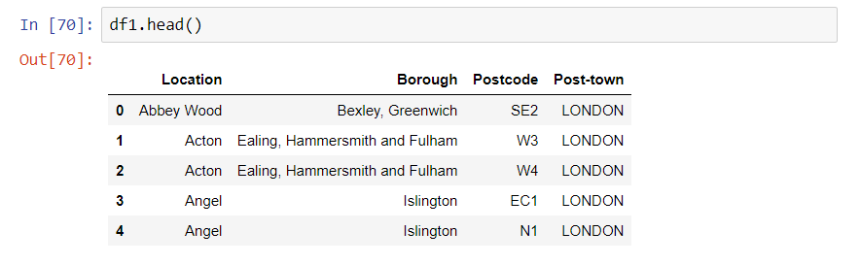
Data Preprocessing
Processed data from WIKIPEDIA page.

Slide 13
Exploratory Data Analysis
Begin by exploring the city and finding the count of neighbourhoods and regions in the city.
Find the unique venues in each neighbourhood.
visualize the neighbourhoods using a folium map.
Obtain top 10 venues at each neighbourhood, which will let us know which neighbourhoods lacks in Indian Restaurant.
By opening a new Restaurant in Indian populated regions, more customers will be satisfied and the venture will be successful and profitable and will lay the foundation for further expansion of company’s chain. Hence, we sort top 10 neighbourhoods based on maximum Indian Population.

Slide 14
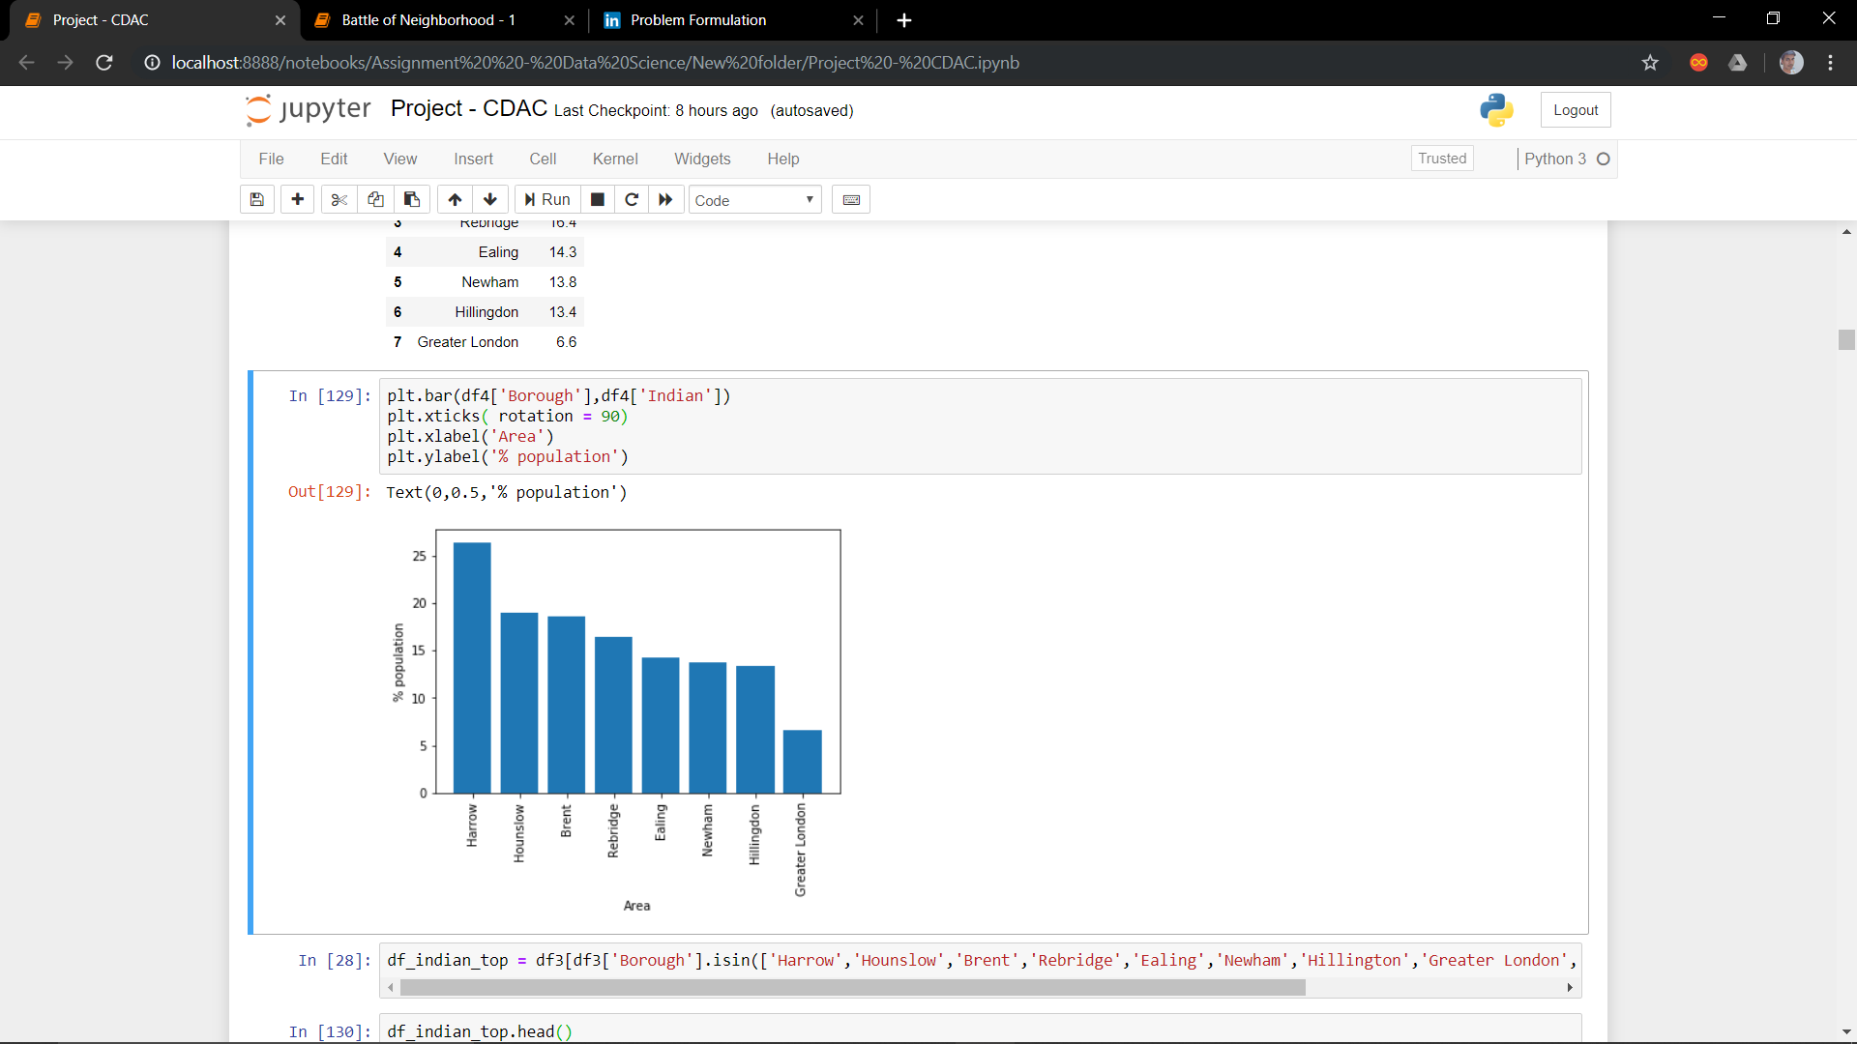
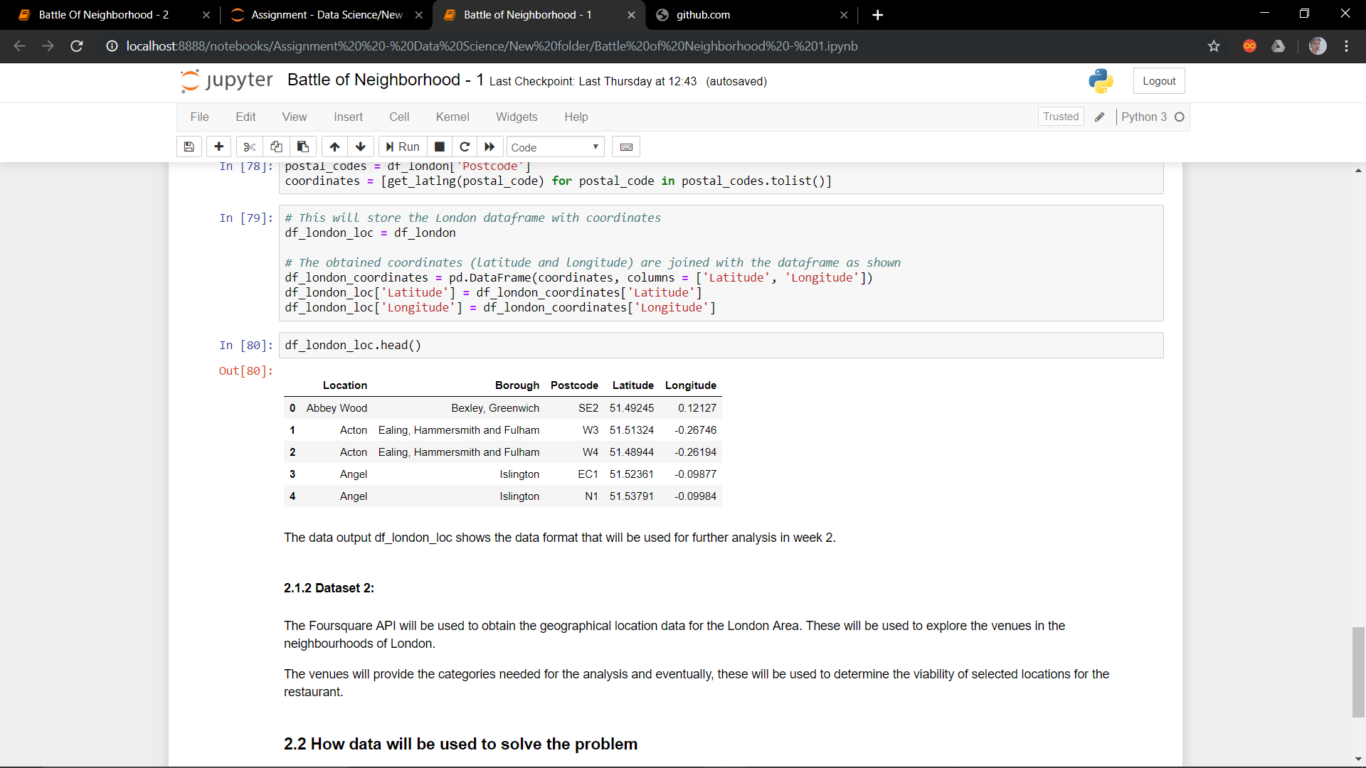
Exploratory Data Analysis
Percentage of Indian Population in
Different Area of London
Filtered Locations of London, along
With its Postcode, Latitude and Longitude.

Slide 15
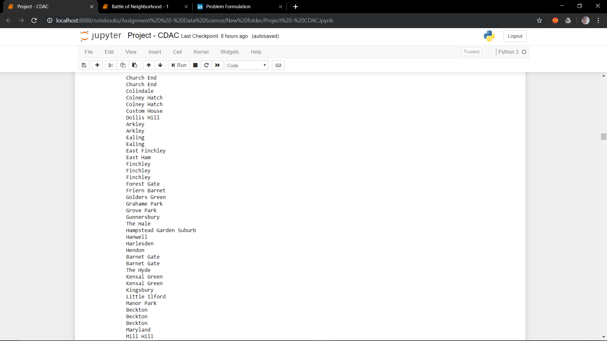
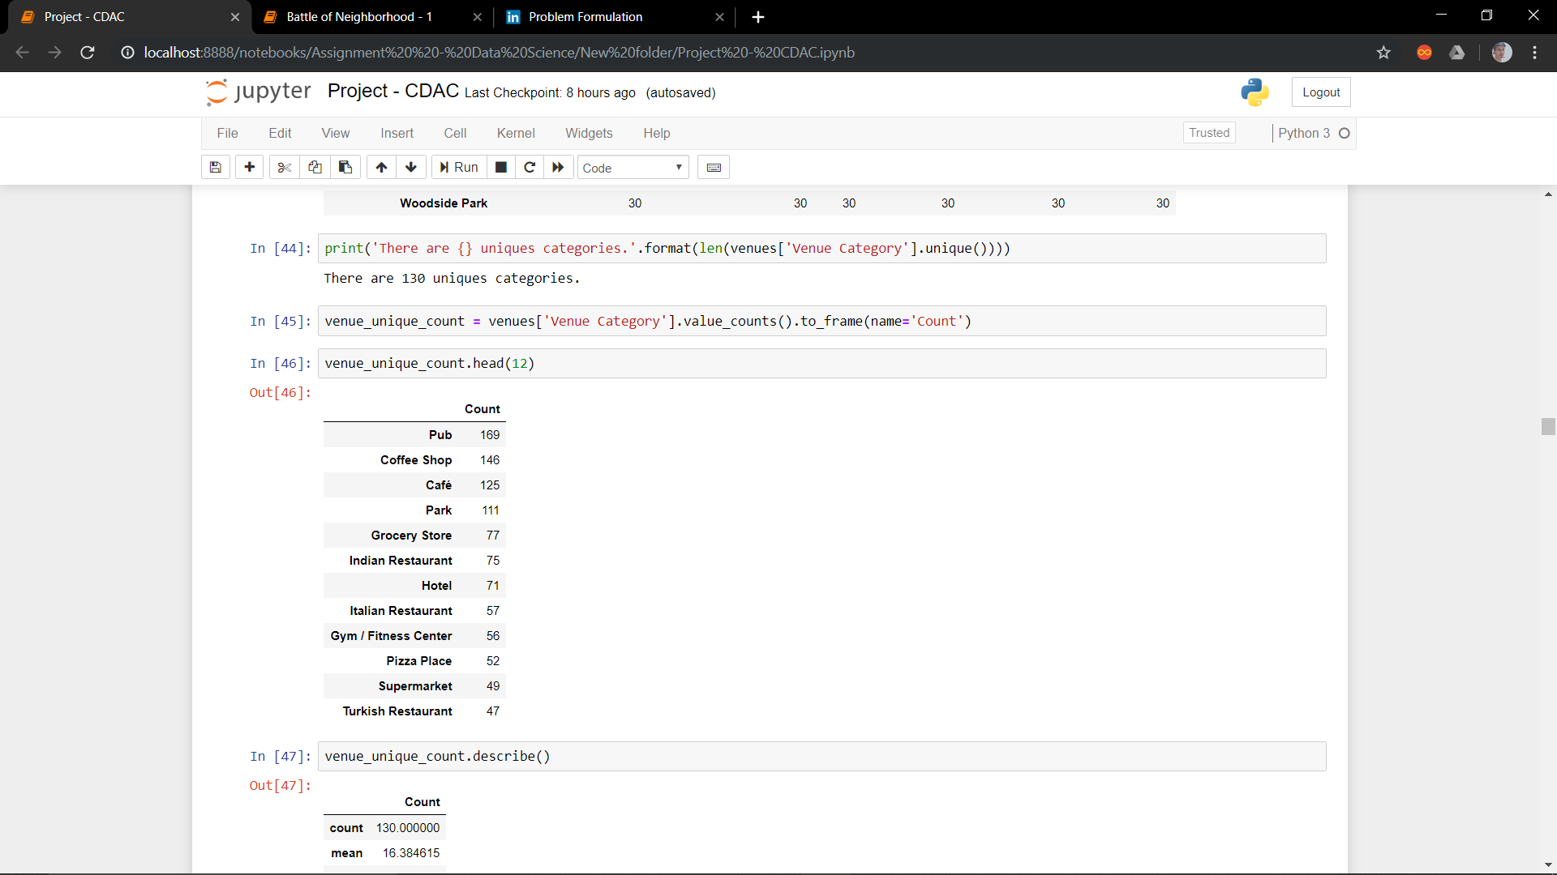
Exploratory Data Analysis
Different Neighborhoods in London
Unique values of venues in our Locations of Interest

Slide 16
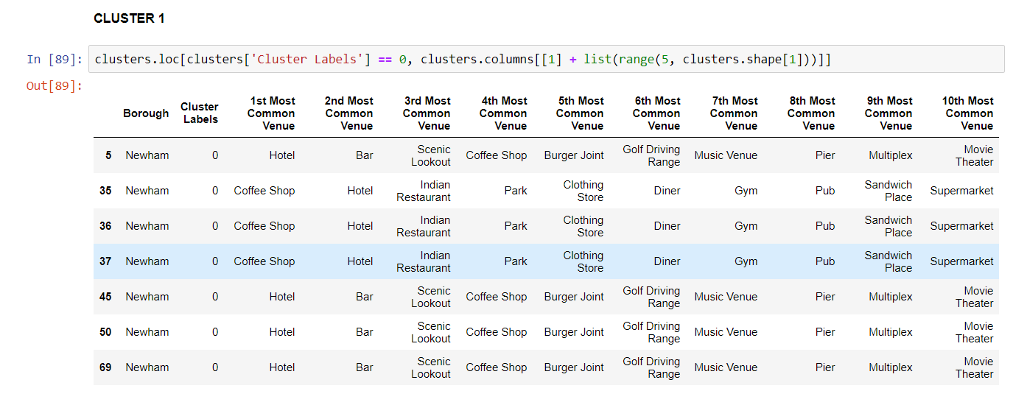
Clustering
Sort the neighbourhoods into five clusters to obtain better insights about each neighbourhood and by that we will know which cluster of neighbourhoods have more population.

Slide 17
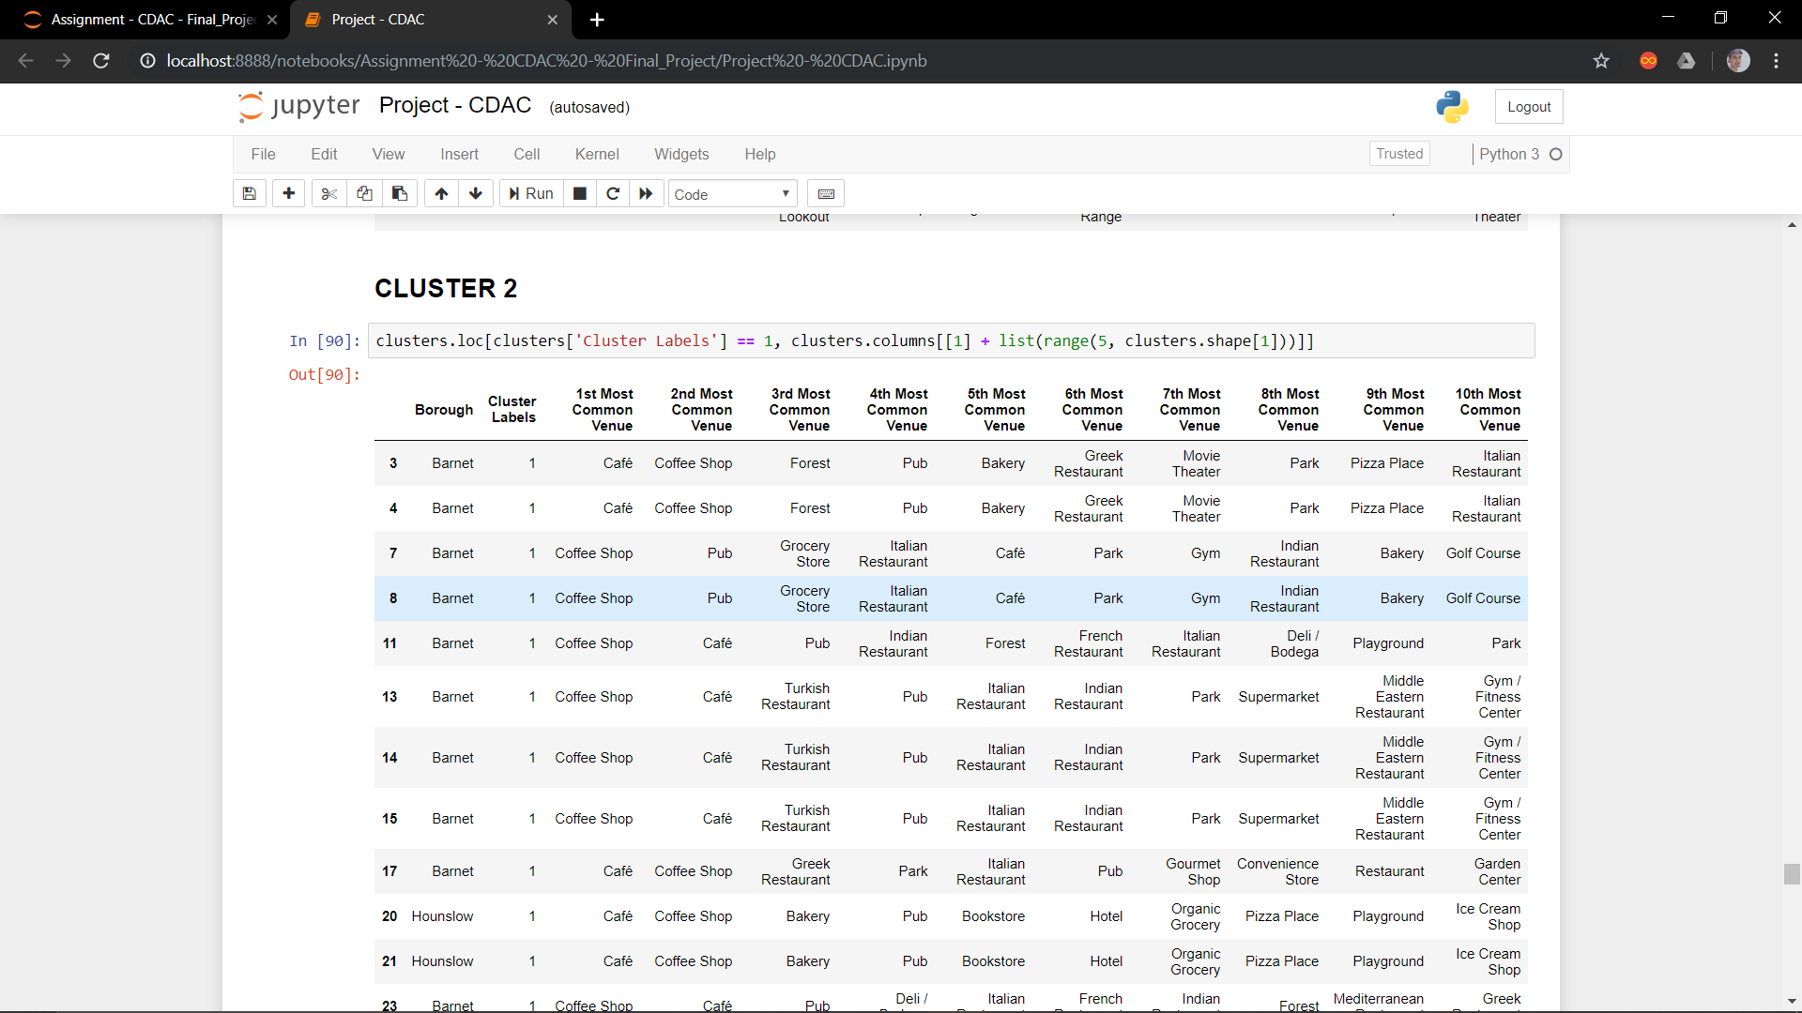
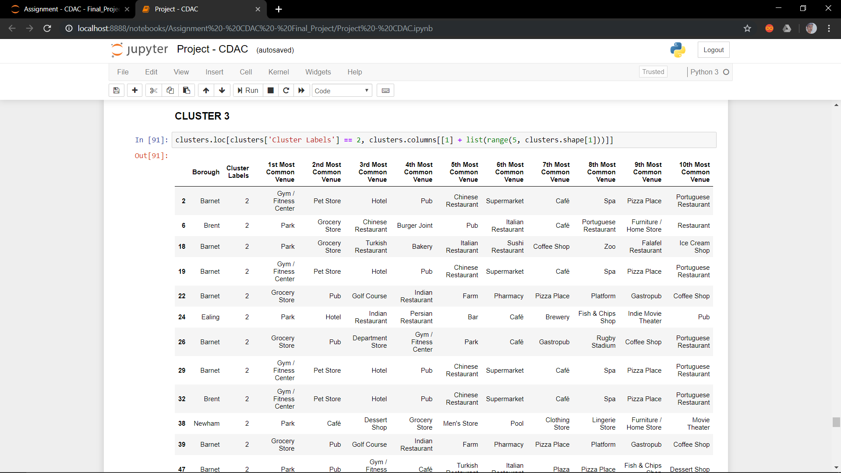
Clustering

Slide 18
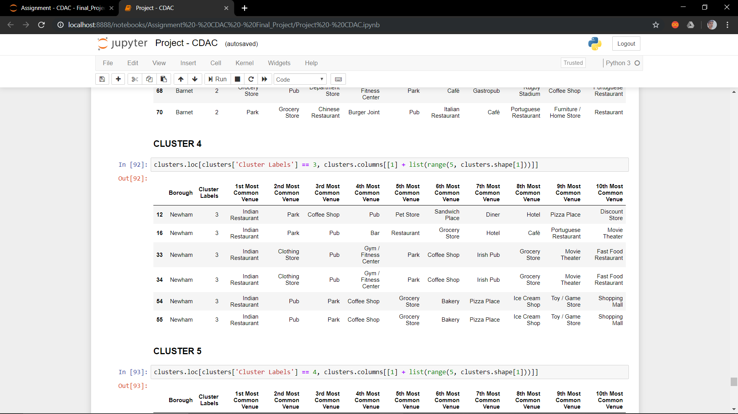
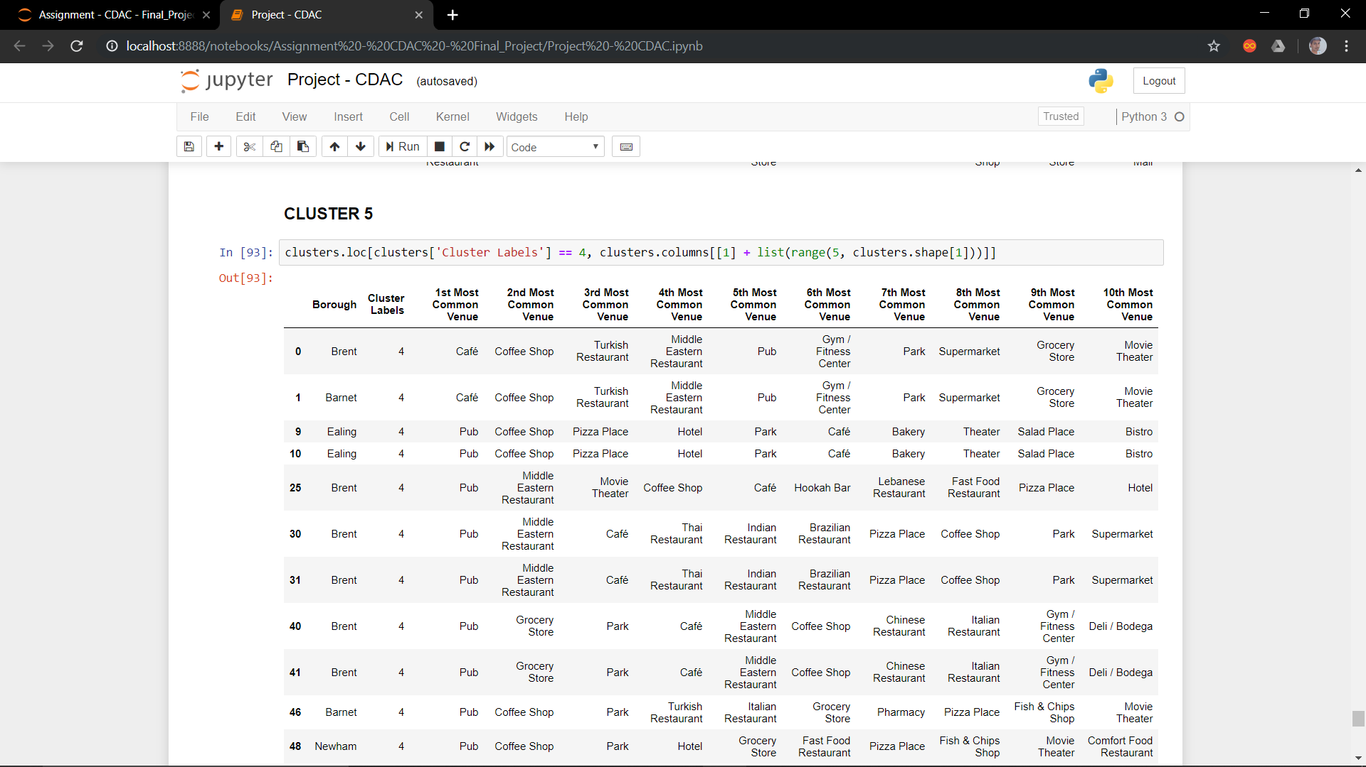
Clustering

Slide 19
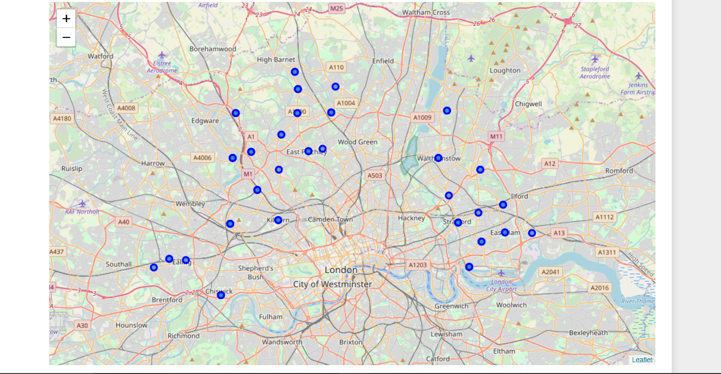
Results and Discussion
Plotting the Neighborhood.

Slide 20
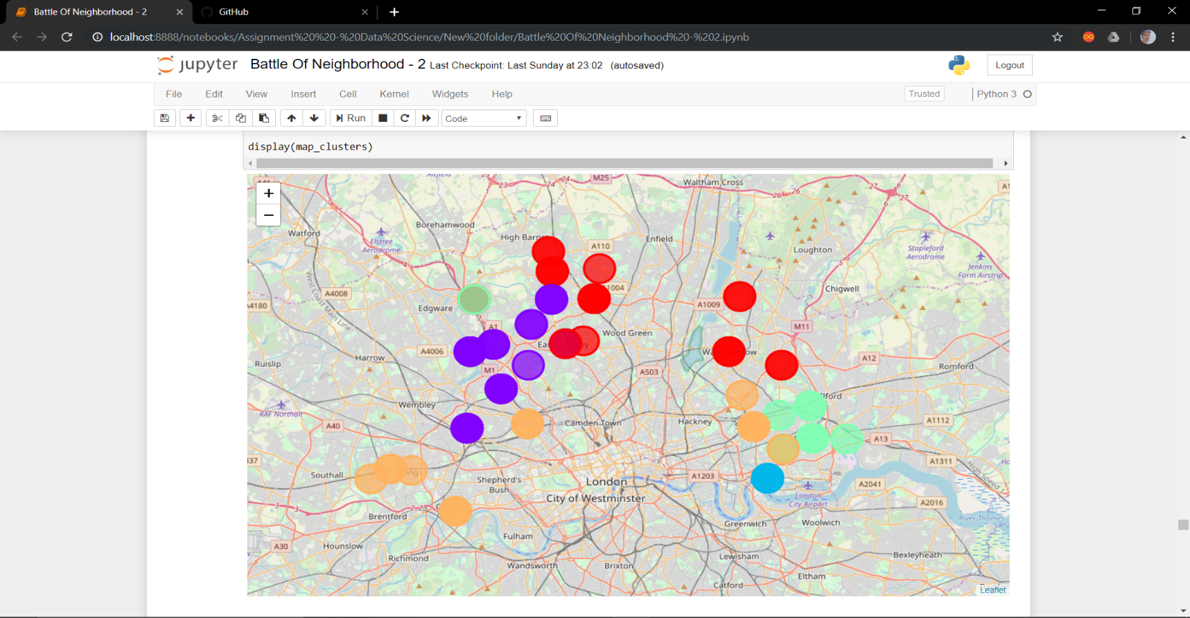
Results and Discussion
By clustering the neighbourhoods, we find that most of the densely populated neighbourhoods belong to the first cluster.

Slide 21
Results and Discussion
HIGHLIGHTS FROM ABOVE 5 CLUSTERS
Pubs, Cafe, Coffee Shops are popular in the London.
As for restaurants, the Italian Restaurants are very popular in the London.
Although, the Clusters have variations, a very visible presence is the dominance of pubs.
We conclude from above observation that CLUSTERS 3 and 5 are scarce in terms of availability of INDIAN RESTAURANTS
Hence, above two mentioned clusters are suitable for opening a new INDIAN RESTAURANT

Slide 22
Conclusion
It is very important to note that Clusters 3 and 5 are the most viable clusters to create a INDIAN RESTAURANT. Their proximity to other amenities and accessibility to INDIAN PEOPLE are paramount. These 2 clusters do not have top restaurants that could rival their standards if they are created.
In conclusion, this project would have had better results if there were more data in terms of crime data within the area, traffic access and allowance of more venues exploration with the Foursquare (limited venues for free calls).
Also, getting the ratings and feedbacks of the current restaurants within the clusters would have helped in providing more insight into the best location.

